Slide 1
Ch8
Convolutional Neural Network
12191682 진태균

Slide 2
Contents
Convolution
Convolutional Neural Network
Kernel
Padding

Slide 3
What is Convolution?
A convolution is a type of matrix operation, consisting of a kernel,
a small matrix of weights, that slides over input data performing
element-wise multiplication with the part of the input it is on,
then summing the results into an output.

Slide 4
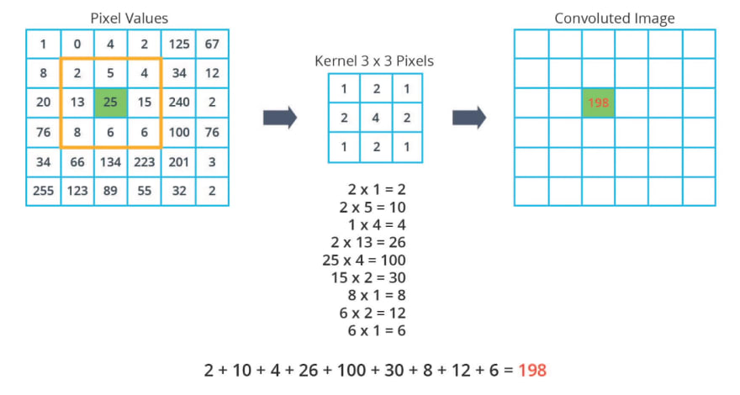
What is Convolution?

Slide 5
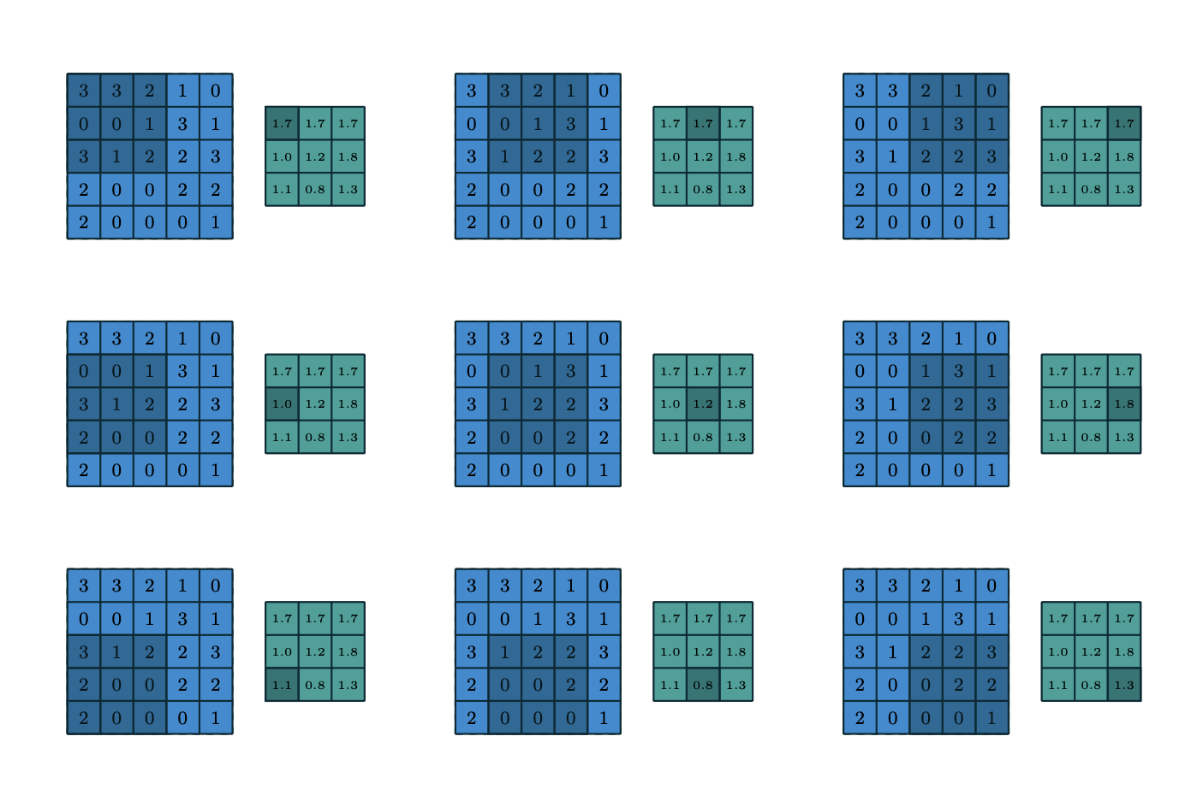
What is Convolution?

Slide 6
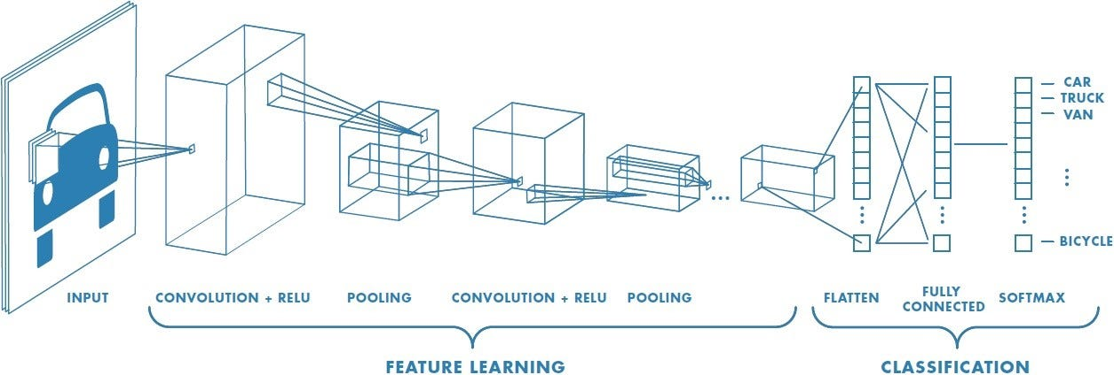
Convolutional Neural Network
One of the deep learning algorithm that can take in an input image,
assign importance to various aspects in the image, and be able to
differentiate one from the other.

Slide 7
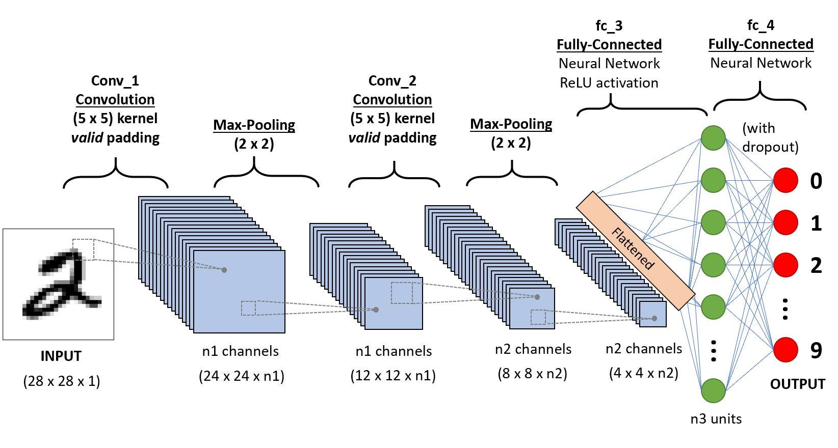
Convolutional Neural Network

Slide 8
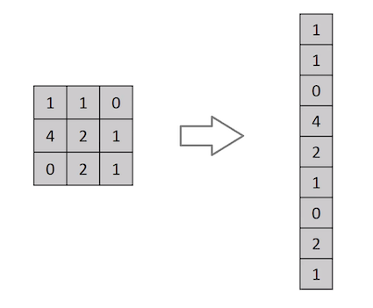
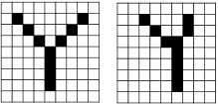
Convolutional Neural Network
2차원의 이미지를 1차원 벡터로 나열할 시,
기존에 가지고 있던 공간적인 구조 정보가
유실될 수 있다.
공간적인 구조(spatial structure) 란 거리가
가까운 픽셀들끼리의 관계이다.
공간적인 구조 정보를 보존하면서 학습할 방법이
CNN을 사용하는 것이다.

Slide 9
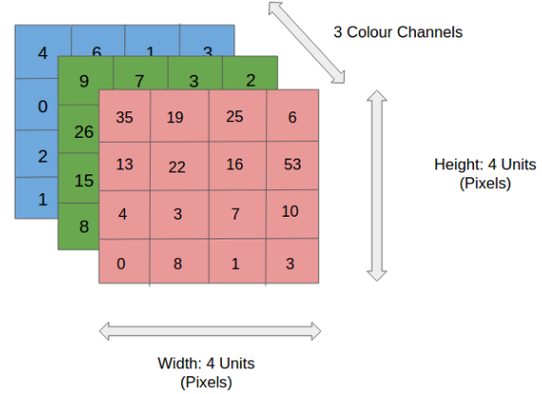
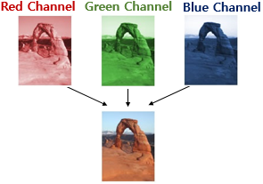
Convolutional Neural Network
이미지가 흑백의 경우, 채널 수가 1이다.
컬러 이미지의 경우, RGB를 활용하여 나타내고
따라서 채널수가 총 3개이다.
Input image

Slide 10
Convolutional Neural Network
흑백 이미지일 때
Kernel (3x3x1)
1 0 1
0 1 0
1 0 1
(5x5x1)
Stride Length = 1

Slide 11
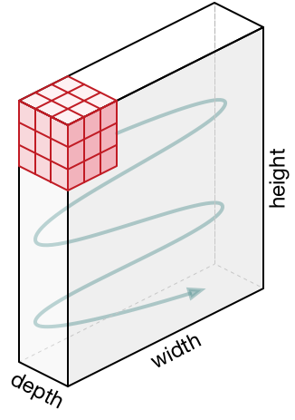
Convolutional Neural Network
padding
Movement of the kernel
(5x5x1)
Stride Length = 1

Slide 12
Convolutional Neural Network
Valid Padding : the convolved feature is reduced in dimesionality as compared to the input.
Same Padding : dimensionality remains the same.

Slide 13
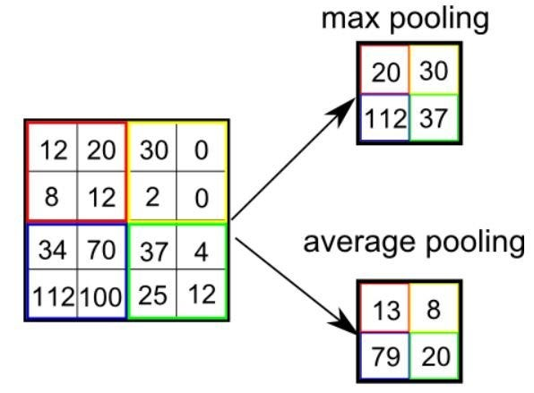
Convolutional Neural Network
Pooling is responsible for reducing the spatial size of Convolved Feature.
- to decrease the computational power required to process the data
- to extract dominant features

Slide 14
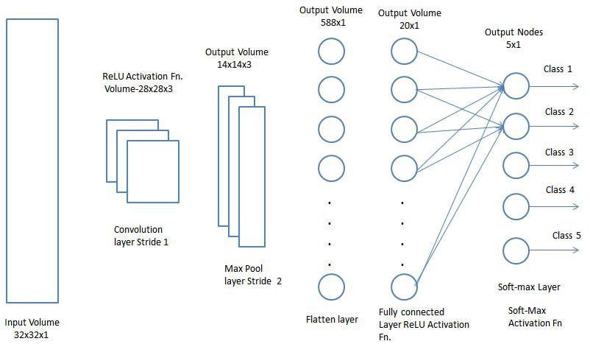
Convolutional Neural Network

